Slide 1
Class 2DC2DD Group 21 SPRINT 3
Group members:
Bárbara Pinto (1191507)
Carlos Dias (1200991)
Cristóvão Sampaio (1201029)
Miguel Silva (1201045)
Martim Maciel (1201154)

Slide 2
Sprint planning – Sprint 2
Planned Start Date: Dec. 6th Real Start Date: Dec. 6th
Planned Finished Date: Jan. 3rd Real Finish Date: Jan. 2nd
SPRINT BACKLOG
Number of stories | 22
Number of bugs | 00
Number of tasks | 64
Number of Management Tasks | 06
Number of team members | Planned: 5 Actual: 5
Total planned estimation vs execution | Planned hours: 5w 2d 5h Executed hours: 3w 3d 8h

Slide 3
Sprint planning
Assignment US | Commited? | Todo | Doing | Testing | Done | Blocked
US301 | Yes |  |  |  | x
US302 | Yes |  |  |  | x
US303 | Yes |  |  |  | x
US304 | Yes |  |  |  | x
US305 | Yes |  |  |  | x
US306 | Yes |  |  |  | x
US307 | Yes |  |  |  | x
US308 | Yes |  |  |  | x
US309 | Yes |  |  |  | x
US310 | Yes |  |  |  | x
US311 | No

Slide 4
Sprint planning
Assignment US | Commited? | Todo | Doing | Testing | Done | Blocked
US312 | Yes |  |  |  | x
US313 | Yes |  |  |  | x
US314 | Yes |  |  |  | x
US315 | Yes |  |  |  | x
US316 | Yes |  |  |  | x
US317 | Yes |  |  |  | x
US318 | Yes |  |  |  | x
US319 | Yes |  |  |  | x
US320 | Yes |  |  |  | x
US321 | Yes |  |  |  | x
US322 | Yes |  |  |  | x

Slide 5
Sprint Execution
Issues | Sprint Backlog (a) | Added issues during sprint (b) | Closed issues from initial planning (c) | Closed issues from added ones (d) | Issues not closed (e) | % Execution
 |  |  |  |  |  | Planned (c/a) | Total (c+d)/(a+b)
Number of stories (I) | 20 | 2 | 19 | 2 | 1 | 95 | 95,5
Number of bugs (II) | 64 | 91 | 0 | 38 | 53 | 0 | 24,5
Number of tasks (III) | 59 | 5 | 59 | 5 | 0 | 100 | 100
TOTAL | 143 | 98 | 78 | 45 | 54 | 65 | 73,3
Total Estimate | 5w 2d 5h

Slide 6
Work by team member

Slide 7
Work by type
Notes:
“Era interessantes inventarem componentes, tais como gestão a 15%”
7

Slide 8
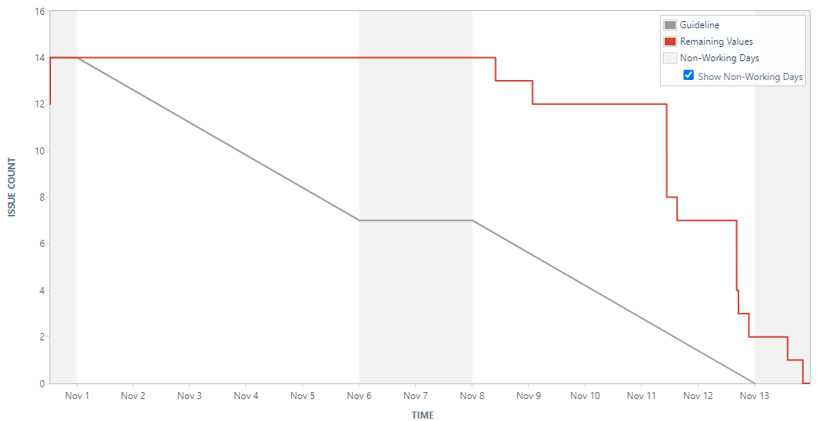
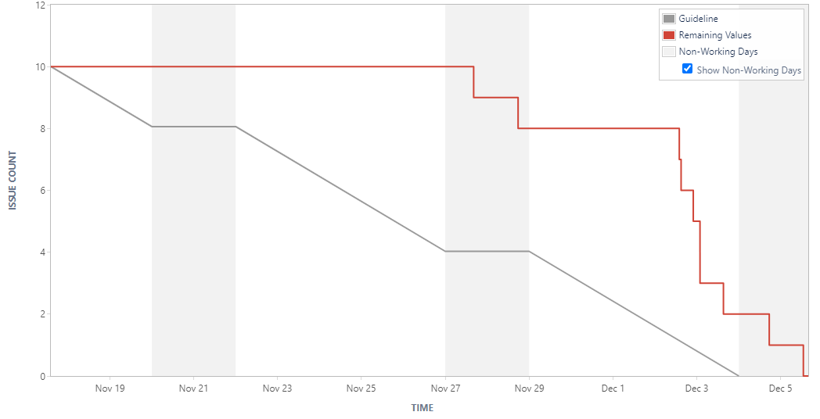
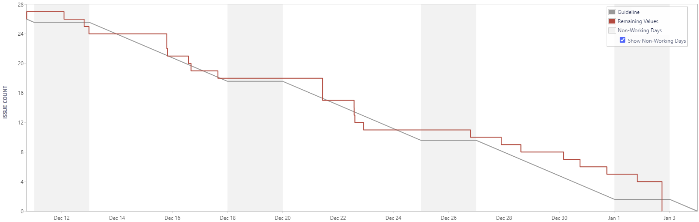
Sprint Burndown Chart
Sprint 1
Sprint 2
Sprint 3

Slide 9
Sprint Review
Date: 03 jan. 2022
Main conclusions
From implemented functionalities:
The new approach to cargo manifest handling (full and partial) was automated succesfully at the database level.
Extended automated cargo manifest handling to storages (ports and warehouses) to keep track of current and estimated occupation - initial plan was only for ships.
A new authentication system was implemented according to requirements. Linking authenticated users with data viewing permissions is still pending (except for clients, which was prioritised).
Mechanisms to register estimated dates for cargo manifests, shipments and trips should be improved – database support for both estimated and actual dates.

Slide 10
Sprint Retrospective
Date: 03 jan. 2022
What went well?
User Story dependencies were well determined.
User Story estimation was accurate, leaving extra time for reviews.
Excellent team work and shared knowledge.
Faster task execution time, as the result of the solid foundation developed in Sprint 1 and previous experience.
Improvements to backlog, with higher comment activity, issue detailing and subtask creation.
What went wrong?
Late or insufficient clarifications from the technical team (FSIAP component).
Late feedback from Sprint 2 evaluations (BDDAD component) blocked the team from implementing necessary database changes in time.
Holiday period generated some delays and slowed work progress a bit.
What we’ve learned?
Estimates must be even more accurate. The overall estimate was close to the actual time, but some User Stories took much longer than predicted while others consumed very off the estimated time.
Project work load must be coordinated with study needs for exams.
Database structure must be reviewed very early in the sprint.

Slide 11
Sprint Retrospective
Date: 03 jan. 2022
Action items:
Project Management:
Update user story estimations when necessary and notify team members.
Create database review subtask at the beginning of the sprint.
Record work logs (time spent) more consistently.
Notes:
11

Slide 12
Team performance metrics
Notes:
“Registar os vários burndowns de várias sprints para ver se há padrões”, “ Ver se a velocidade tá a aumentar, diminuir, ou é constante”
12

